Slide 1
Guide to Computer Forensics and Investigations
Third Edition
Chapter 9
Computer Forensics Analysis and Validation

Slide 2
Objectives
Determine what data to analyze in a computer forensics investigation
Explain tools used to validate data
Explain common data-hiding techniques
Describe methods of performing a remote acquisition
Guide to Computer Forensics and Investigations

Slide 3
Determining What Data to Collect and Analyze
Examining and analyzing digital evidence depends on:
  Nature of the case
  Amount of data to process
  Search warrants and court orders
  Company policies
Scope creep
  Investigation expands beyond the original description
Right of full discovery of digital evidence
Guide to Computer Forensics and Investigations

Slide 4
Approaching Computer Forensics Cases
Some basic principles apply to almost all computer forensics cases
  The approach you take depends largely on the specific type of case you’re investigating
Basic steps for all computer forensics investigations
  For target drives, use only recently wiped media that have been reformatted
    And inspected for computer viruses
Guide to Computer Forensics and Investigations

Slide 5
Approaching Computer Forensics Cases (continued)
Basic steps for all computer forensics investigations (continued)
  Inventory the hardware on the suspect’s computer and note the condition of the computer when seized
  Remove the original drive from the computer
    Check date and time values in the system’s CMOS
  Record how you acquired data from the suspect drive
  Process the data methodically and logically
Guide to Computer Forensics and Investigations

Slide 6
Approaching Computer Forensics Cases (continued)
Basic steps for all computer forensics investigations (continued)
  List all folders and files on the image or drive
  If possible, examine the contents of all data files in all folders
    Starting at the root directory of the volume partition
  For all password-protected files that might be related to the investigation
    Make your best effort to recover file contents
Guide to Computer Forensics and Investigations

Slide 7
Approaching Computer Forensics Cases (continued)
Basic steps for all computer forensics investigations (continued)
  Identify the function of every executable (binary or .exe) file that doesn’t match known hash values
  Maintain control of all evidence and findings, and document everything as you progress through your examination
Guide to Computer Forensics and Investigations

Slide 8
Refining and Modifying the Investigation Plan
Considerations
  Determine the scope of the investigation
  Determine what the case requires
  Whether you should collect all information
  What to do in case of scope creep
The key is to start with a plan but remain flexible in the face of new evidence
Guide to Computer Forensics and Investigations

Slide 9
Using AccessData Forensic Toolkit to Analyze Data
Supported file systems: FAT12/16/32, NTFS, Ext2fs, and Ext3fs
FTK can analyze data from several sources, including image files from other vendors
FTK produces a case log file
Searching for keywords
  Indexed search
  Live search
  Supports options and advanced searching techniques, such as stemming
Guide to Computer Forensics and Investigations

Slide 10
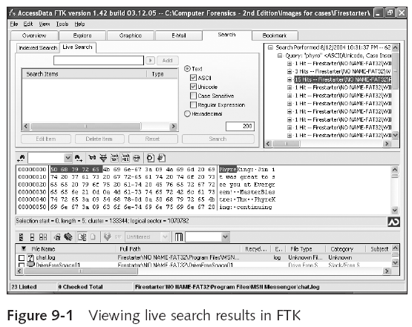
Using AccessData Forensic Toolkit to Analyze Data (continued)
Guide to Computer Forensics and Investigations

Slide 11
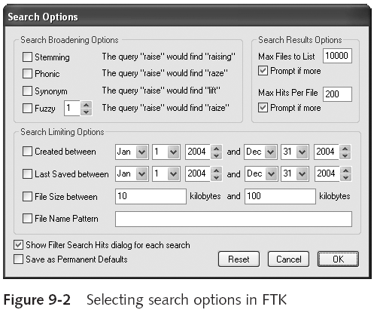
Using AccessData Forensic Toolkit to Analyze Data (continued)
Guide to Computer Forensics and Investigations

Slide 12
Using AccessData Forensic Toolkit to Analyze Data (continued)
Analyzes compressed files
You can generate reports
  Using bookmarks
Guide to Computer Forensics and Investigations

Slide 13
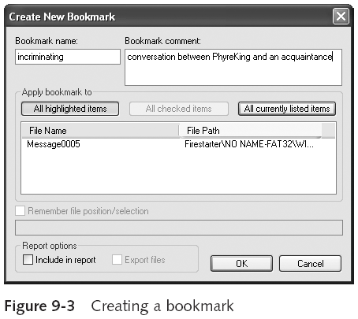
Using AccessData Forensic Toolkit to Analyze Data (continued)
Guide to Computer Forensics and Investigations

Slide 14
Validating Forensic Data
One of the most critical aspects of computer forensics
Ensuring the integrity of data you collect is essential for presenting evidence in court
Most computer forensic tools provide automated hashing of image files
Computer forensics tools have some limitations in performing hashing
  Learning how to use advanced hexadecimal editors is necessary to ensure data integrity
Guide to Computer Forensics and Investigations

Slide 15
Validating with Hexadecimal Editors
Advanced hexadecimal editors offer many features not available in computer forensics tools
  Such as hashing specific files or sectors
Hex Workshop provides several hashing algorithms
  Such as MD5 and SHA-1
  See Figures 9-4 through 9-6
Hex Workshop also generates the hash value of selected data sets in a file or sector
Guide to Computer Forensics and Investigations

Slide 16
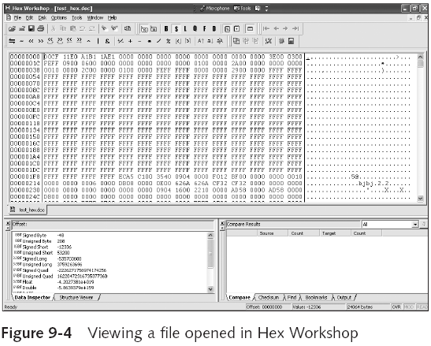
Validating with Hexadecimal Editors (continued)
Guide to Computer Forensics and Investigations

Slide 17
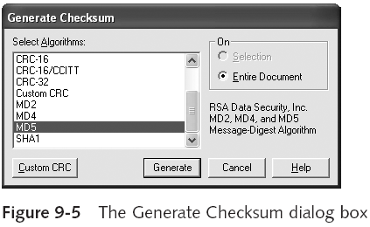
Validating with Hexadecimal Editors (continued)
Guide to Computer Forensics and Investigations

Slide 18
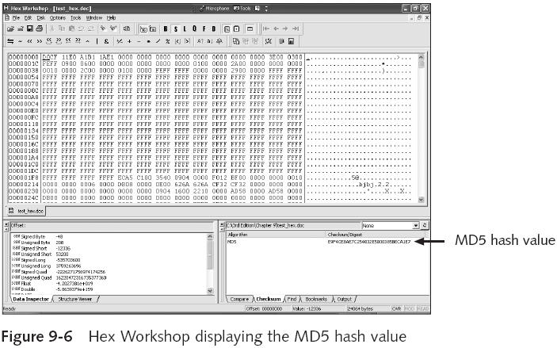
Validating with Hexadecimal Editors (continued)
Guide to Computer Forensics and Investigations

Slide 19
Validating with Hexadecimal Editors (continued)
Using hash values to discriminate data
  AccessData has a separate database, the Known File Filter (KFF)
    Filters known program files from view, such as MSWord.exe, and identifies known illegal files, such as child pornography
  KFF compares known file hash values to files on your evidence drive or image files
  Periodically, AccessData updates these known file hash values and posts an updated KFF
Guide to Computer Forensics and Investigations

Slide 20
Validating with Computer Forensics Programs
Commercial computer forensics programs have built-in validation features
ProDiscover’s .eve files contain metadata that includes the hash value
  Validation is done automatically
Raw format image files (.dd extension) don’t contain metadata
  So you must validate raw format image files manually to ensure the integrity of data
Guide to Computer Forensics and Investigations

Slide 21
Validating with Computer Forensics Programs (continued)
In AccessData FTK Imager
  When you select the Expert Witness (.e01) or the SMART (.s01) format
    Additional options for validating the acquisition are displayed
  Validation report lists MD5 and SHA-1 hash values
Figure 9-7 shows how ProDiscover’s built-in validation feature works
Guide to Computer Forensics and Investigations

Slide 22
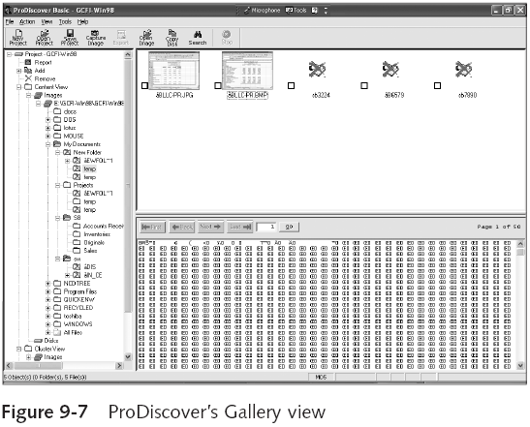
Validating with Computer Forensics Programs (continued)
Guide to Computer Forensics and Investigations

Slide 23
Addressing Data-hiding Techniques
File manipulation
  Filenames and extensions
  Hidden property
Disk manipulation
  Hidden partitions
  Bad clusters
Encryption
  Bit shifting
  Steganography
Guide to Computer Forensics and Investigations

Slide 24
Hiding Partitions
Delete references to a partition using a disk editor
  Re-create links for accessing it
Use disk-partitioning utilities
  GDisk
  PartitionMagic
  System Commander
  LILO
Account for all disk space when analyzing a disk
Guide to Computer Forensics and Investigations

Slide 25
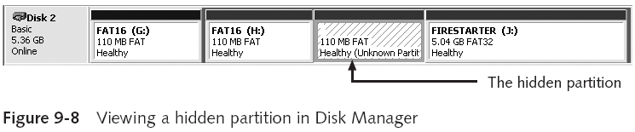
Hiding Partitions (continued)
Guide to Computer Forensics and Investigations

Slide 26
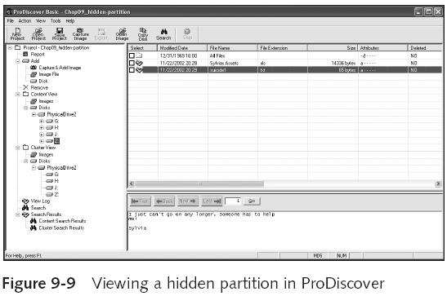
Hiding Partitions (continued)
Guide to Computer Forensics and Investigations

Slide 27
Marking Bad Clusters
Common with FAT systems
Place sensitive information on free space
Use a disk editor to mark space as a bad cluster
To mark a good cluster as bad using Norton Disk Edit
  Type B in the FAT entry corresponding to that cluster
Guide to Computer Forensics and Investigations

Slide 28
Bit-shifting
Old technique
Shift bit patterns to alter byte values of data
Make files look like binary executable code
Tool
  Hex Workshop
Guide to Computer Forensics and Investigations

Slide 29
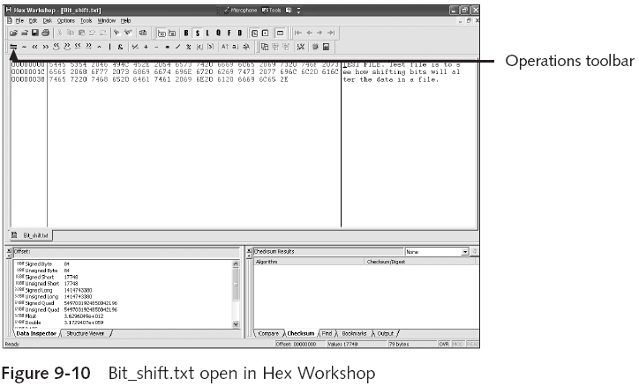
Bit-shifting (continued)
Guide to Computer Forensics and Investigations

Slide 30
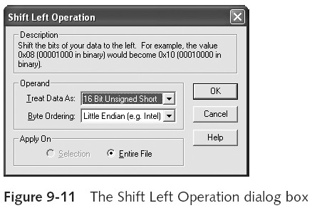
Bit-shifting (continued)
Guide to Computer Forensics and Investigations

Slide 31
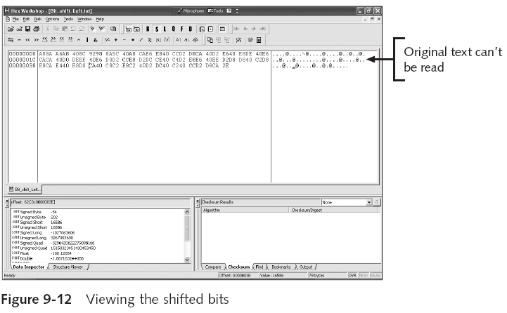
Bit-shifting (continued)
Guide to Computer Forensics and Investigations

Slide 32
Using Steganography to Hide Data
Greek for “hidden writing”
Steganography tools were created to protect copyrighted material
  By inserting digital watermarks into a file
Suspect can hide information on image or text document files
  Most steganography programs can insert only small amounts of data into a file
Very hard to spot without prior knowledge
Tools: S-Tools, DPEnvelope, jpgx, and tte
Guide to Computer Forensics and Investigations

Slide 33
Examining Encrypted Files
Prevent unauthorized access
  Employ a password or passphrase
Recovering data is difficult without password
  Key escrow
    Designed to recover encrypted data if users forget their passphrases or if the user key is corrupted after a system failure
  Cracking password
    Expert and powerful computers
  Persuade suspect to reveal password
Guide to Computer Forensics and Investigations

Slide 34
Recovering Passwords
Techniques
  Dictionary attack
  Brute-force attack
  Password guessing based on suspect’s profile
Tools
  AccessData PRTK
  Advanced Password Recovery Software Toolkit
  John the Ripper
Guide to Computer Forensics and Investigations

Slide 35
Recovering Passwords (continued)
Using AccessData tools with passworded and encrypted files
  AccessData offers a tool called Password Recovery Toolkit (PRTK)
    Can create possible password lists from many sources
  Can create your own custom dictionary based on facts in the case
  Can create a suspect profile and use biographical information to generate likely passwords
Guide to Computer Forensics and Investigations

Slide 36
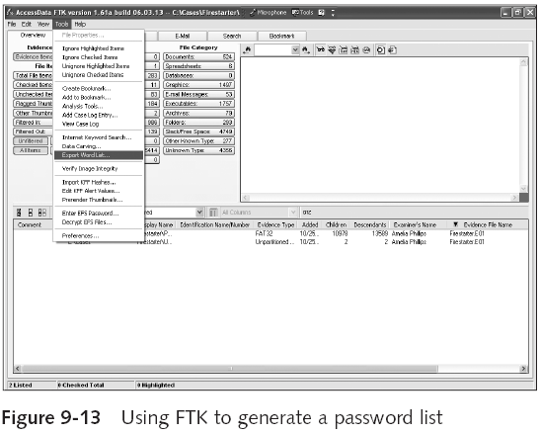
Recovering Passwords (continued)
Guide to Computer Forensics and Investigations

Slide 37
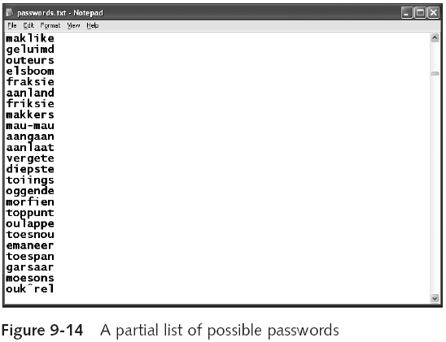
Recovering Passwords (continued)
Guide to Computer Forensics and Investigations

Slide 38
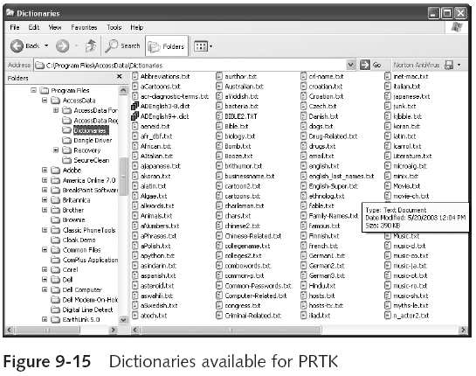
Recovering Passwords (continued)
Guide to Computer Forensics and Investigations

Slide 39
Recovering Passwords (continued)
Using AccessData tools with passworded and encrypted files (continued)
  FTK can identify known encrypted files and those that seem to be encrypted
    And export them
  You can then import these files into PRTK and attempt to crack them
Guide to Computer Forensics and Investigations

Slide 40
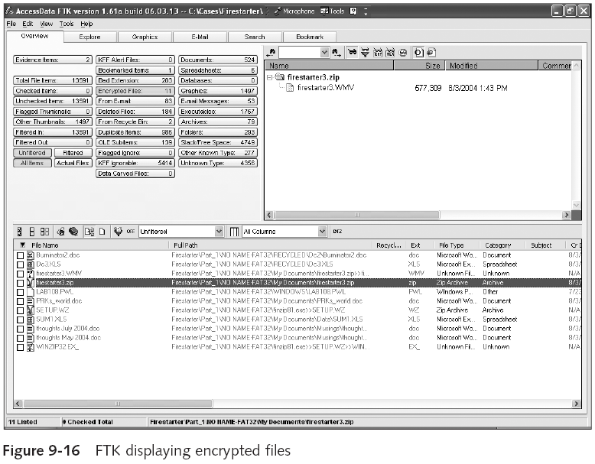
Guide to Computer Forensics and Investigations

Slide 41
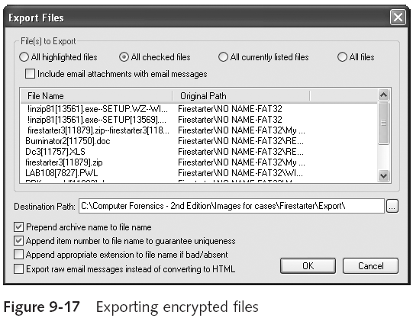
Recovering Passwords (continued)
Guide to Computer Forensics and Investigations

Slide 42
Performing Remote Acquisitions
Remote acquisitions are handy when you need to image the drive of a computer far away from your location
  Or when you don’t want a suspect to be aware of an ongoing investigation
Guide to Computer Forensics and Investigations

Slide 43
Remote Acquisitions with Runtime Software
Runtime Software offers the following shareware programs for remote acquisitions:
  DiskExplorer for FAT
  DiskExplorer for NTFS
  HDHOST
Preparing DiskExplorer and HDHOST for remote acquisitions
  Requires the Runtime Software, a portable media device (USB thumb drive or floppy disk), and two networked computers
Guide to Computer Forensics and Investigations

Slide 44
Remote Acquisitions with Runtime Software (continued)
Making a remote connection with DiskExplorer
  Requires running HDHOST on a suspect’s computer
  To establish a connection with HDHOST, the suspect’s computer must be:
    Connected to the network
    Powered on
    Logged on to any user account with permission to run noninstalled applications
  HDHOST can’t be run surreptitiously
  See Figures 9-18 through 9-24
Guide to Computer Forensics and Investigations

Slide 45
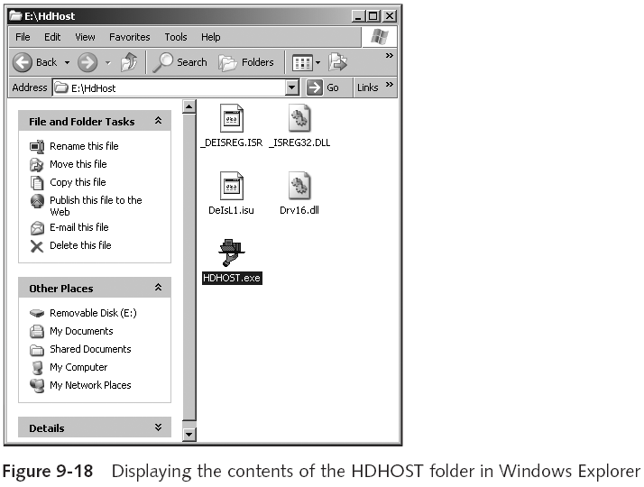
Guide to Computer Forensics and Investigations

Slide 46
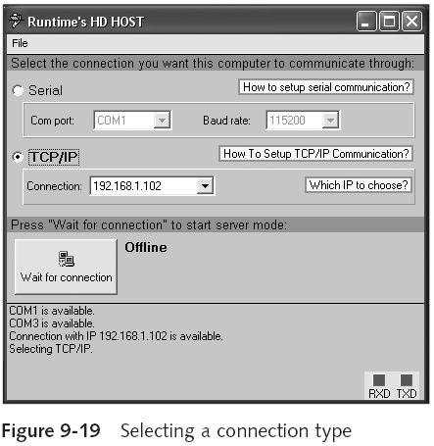
Remote Acquisitions with Runtime Software (continued)
Guide to Computer Forensics and Investigations

Slide 47
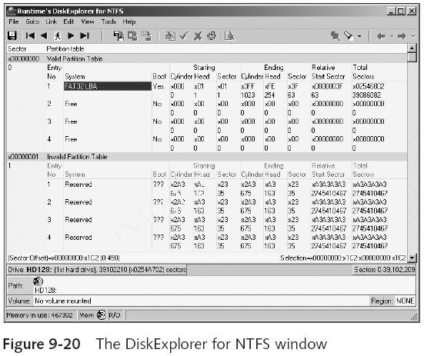
Remote Acquisitions with Runtime Software (continued)
Guide to Computer Forensics and Investigations

Slide 48
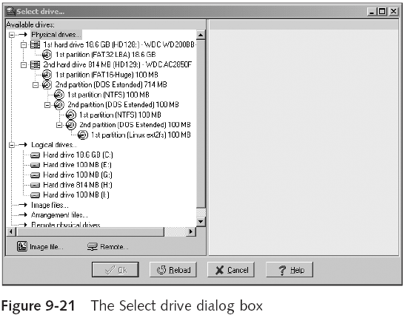
Remote Acquisitions with Runtime Software (continued)
Guide to Computer Forensics and Investigations

Slide 49
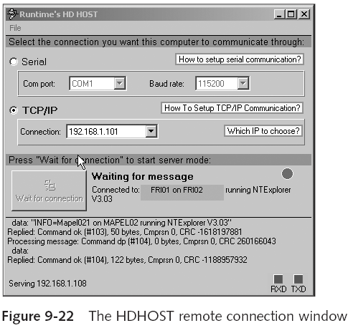
Remote Acquisitions with Runtime Software (continued)
Guide to Computer Forensics and Investigations

Slide 50
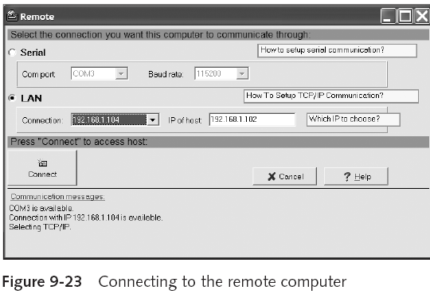
Remote Acquisitions with Runtime Software (continued)
Guide to Computer Forensics and Investigations

Slide 51
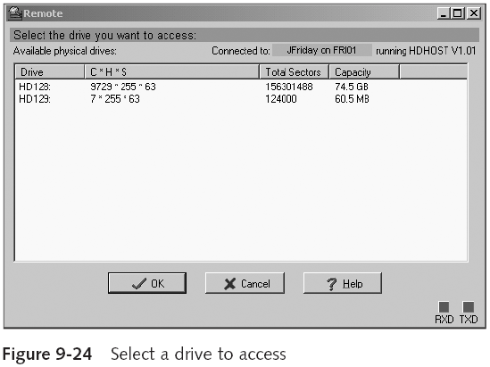
Remote Acquisitions with Runtime Software (continued)
Guide to Computer Forensics and Investigations

Slide 52
Remote Acquisitions with Runtime Software (continued)
Making a remote acquisition with DiskExplorer
  After you have established a connection with DiskExplorer from the acquisition workstation
    You can navigate through the suspect computer’s files and folders or copy data
  The Runtime tools don’t generate a hash for acquisitions
Guide to Computer Forensics and Investigations

Slide 53
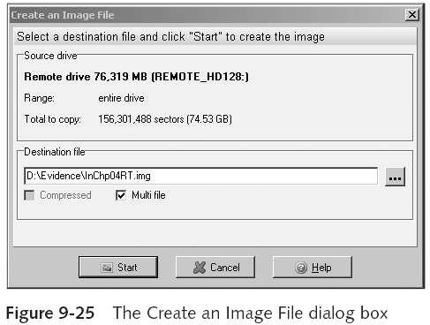
Remote Acquisitions with Runtime Software (continued)
Guide to Computer Forensics and Investigations

Slide 54
Summary
Examining and analyzing digital evidence depends on the nature of the investigation and the amount of data you have to process
For most computer forensics investigations, you follow the same general procedures
One of the most critical aspects of computer forensics is validating digital evidence
Guide to Computer Forensics and Investigations

Slide 55
Summary (continued)
Data hiding involves changing or manipulating a file to conceal information
Remote acquisitions are useful for making an image of a drive when the computer is far away from your location or when you don’t want a suspect to be aware of an ongoing investigation
Guide to Computer Forensics and Investigations

